Slide 1
Turkish Dictionaries' Headword Selection Strategies from 1998 to Present
Emrah Özcan
Yıldız Technical University

Slide 2
A little about myself
My name is Emrah
I am a research assistant @ Yıldız Technical University, ELT Dept.
And doing my PhD @ Ankara Uni., Linguistics Dept.
My main interest is dictionary typology and dictionary criticism.

Slide 3
Background of The Project
Turkish Language Reform (1928)
  Alphabet changed from Arabic script to Latin script
  Aim is to “get rid of” foreign words in the language and propose new words instead
  A big dictionary project started by Turkish Language Institution (TDK).

Slide 4
Background of The Project
Turkish Language Reform (1928)
  Aim is to “get rid of” foreign words in the language and propose new words instead
  A big dictionary project started by Turkish Language Institution (TDK).
The first edition was printed in 1943
And there are 11 editions of the Turkish Dictionary so far…

Slide 5
Background of The Project
Ergenç & Uzun (1993) analyzes Turkish dictionaries printed from 1943 to 1988 (8 editions)
They tried to understand which words entered the dictionary
And which words exited the dictionary in each edition

Slide 6
Background of The Project
The number entering words is the highest in the 7th (1983) edition (9758).
The lowest number of entering words is in the 4th (1966) edition (373).
The highest exiting words are in the 5th (1969) and 2nd (1955) editions with a very close difference.
  As mentioned earlier, as part of the language reform many new words were proposed in the 4th (1966) edition and most of them were cleared out in the 5th (1969) edition as they failed to adhere.

Slide 7
Background of The Project
The number entering words is the highest in the 7th (1983) edition (9758).
The lowest number of entering words is in the 4th (1966) edition (373).
The highest exiting words are in the 5th (1969) and 2nd (1955) editions with a very close difference.
  As mentioned earlier, as part of the language reform many new words were proposed in the 4th (1966) edition and most of them were cleared out in the 5th (1969) edition as they failed to adhere.

Slide 8
Background of The Project
The lowest exiting words are in the 3rd(1959), 4th(1966) and 8th(1988) editions.
The highest expansion occurred within the 7th(1983) edition and lowest expansion occurred in the 3rd(1959) edition.

Slide 9
Background of The Project
The most active languages are Arabic, French and Persian.
Except the 4th (1966) edition, French has the most entering words and adherence in the dictionary until the 8th (1988) edition.

Slide 10
Background of The Project
In the 5th (1969) edition, Arabic was the most affected language with exiting words until the 8th (1988) edition.
In the 8th (1988) edition, expanding started to drop. This is the edition where foreign entering words come close to native entering words.

Slide 11
Background of The Project
According to Ergenç & Uzun (1993) the number of entering words are more than the number of exiting words, therefore this provided a growth in the number entries that stayed in the dictionary.

Slide 12
Background of The Project
Starting from the first edition up to 6th (1974) edition, the dictionary contains “more Turkish” words rather than foreign loan words among different editions
Administration changes, military coup d'etats (1960 and 1980) and some other non-lexical/linguistic factors affect the content of the dictionary

Slide 13
My Project
My aim in this project is to do a similar analysis for the editions not covered in Ergenç & Uzun (1993)
And use GROBID-dictionaries to convert PDF versions of the latest editions of the Turkish Dictionary into TEI

Slide 14
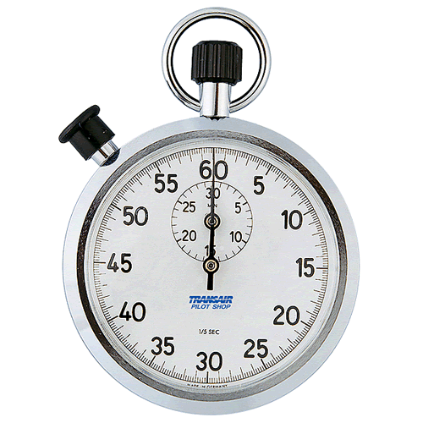
Time’s Up!
About your speaker:
  Name: Emrah Özcan
  Institution: Yıldız Technical Uni.
  Social Media: @mrhzcn
  Quick bio: Research Assistant
  @Yıldız Technical University, ELT Dept.
  http://mrhzcn.com/

